Slide 1

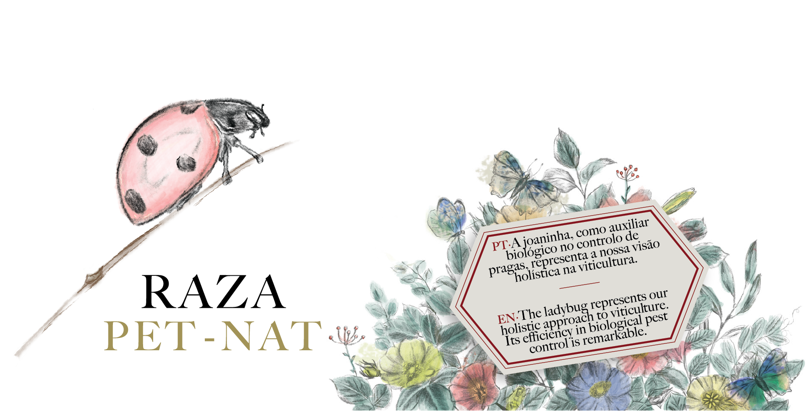

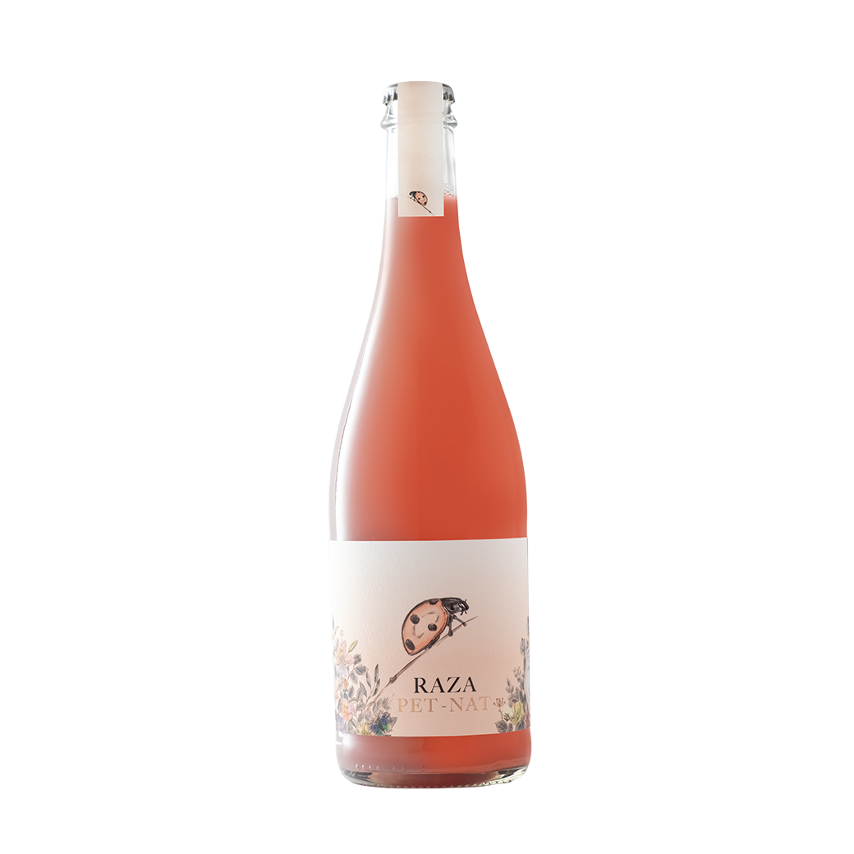

Product: Natural Sparkling Rose Wine | IG Minho
Grape Variety: Padeiro, Vinhão
Vintage: 2025
Alcohol: 12 % vol.
Total Acidity: 5,5 g (tartaric acid/l)
Residual Sugar: Dry
pH: 3,23
WINEMAKING PROCESS
With this RAZA PET NAT, we're returning to an ancient way of producing our wines This RAZA PET NAT reflects a minimal intervention approach, letting nature dictate the fermentation with wild yeasts. Spontaneous fermentation ends in the bottle with no sulphites added, creating a fine, persistent bubble and a natural sediment. The wine is not filtered.
TASTING NOTES
A very fruity wine with fine, persistent bubbles. Refreshing and full of red fruit and wild yeast flavours. Its natural sediment makes the wine cloudy while increasing the complexity of the flavours. Suitable for vegans.
FOOD PAIRINGS
Appetizer, fatty fish, spicy food and festive occasions
RECOMMENDATIONS
Service temperature between 6º - 8ºC.
www.quintadaraza.pt

Slide 2


